Slide 1
A new stationary analytical model of the heliospheric current sheet and the plasma sheet
Roman Kislov
IKI RAS
2015
kr-rk@bk.ru

Slide 2
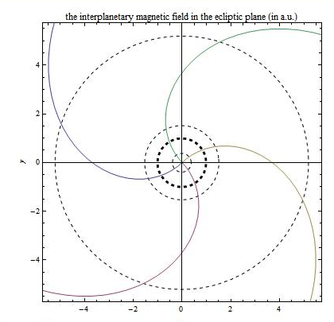
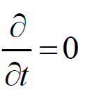
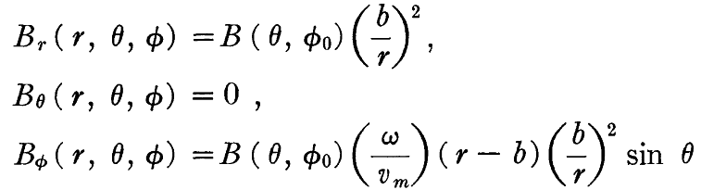
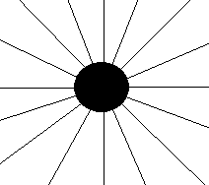
The IMF expansion according to the Parker’s model
a steady and purely radial outflow of the coronal plasma
a “frozen-in” magnetic field
a Parker’ spiral form of the IMF
the radial IMF component |B_{r}|~r ⁻²
Parker 1958, 1963

Slide 3
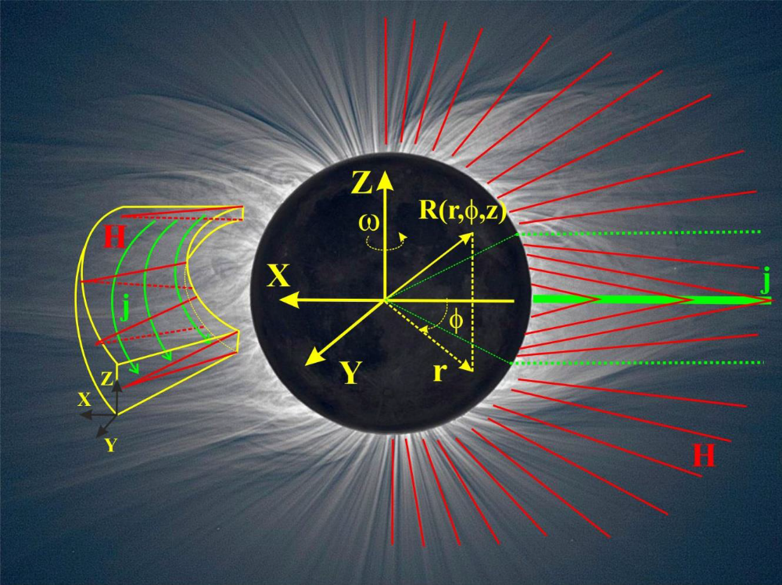
Heliospheric current sheet (HCS) and plasma sheet (HPS)

Slide 4
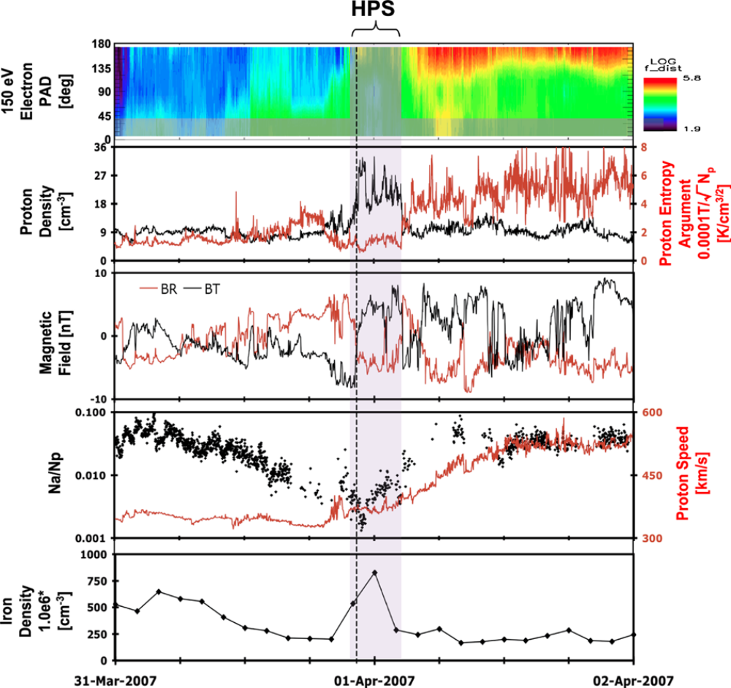
Heliospheric plasma sheet
Local density maximum
Minimum of the magnetic field
proton speed 400 km/s
thickness less than 10 R₀ .
K.D.C. Simunac · A.B. Galvin · C.J. Farrugia · L.M. Kistler · H. Kucharek ·
B. Lavraud · Y.C.-M. Liu · J.G. Luhmann · K.W. Ogilvie · A. Opitz · M.A. Popecki ·
J.-A. Sauvaud · S. Wang
2012
Notes:
Штрих-линия – ГТС. 3 центральные панели. ГТС бывает как смещённым, так и нет. ГПС – тень(shaded). ГПС – место, где поле уже упало, а плазмы ещё много. ГТС заметно менее 10000 км, ПС – менее 5 R солнца (Winterhunter 1994)

Slide 5
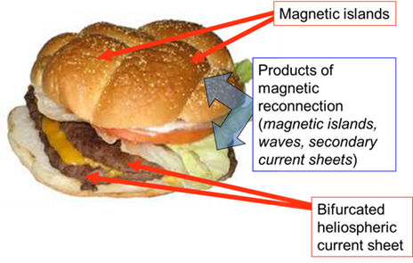
Plasma sheet structure

Slide 6
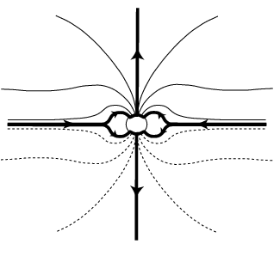
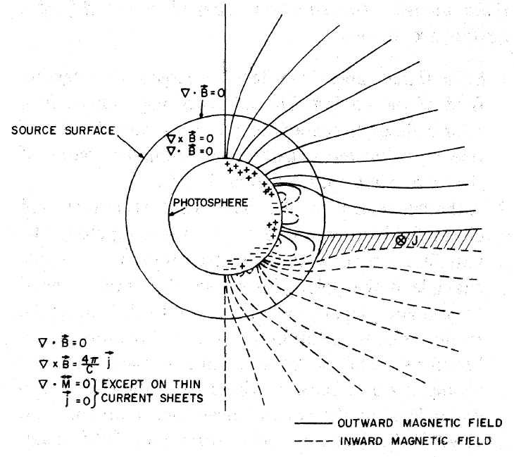
Models of HCS and HPS
Large scales models of the HCS as thin rotating plasma disk. Internal structure is not important.
Alfven 1977,1981; Israelevich et al., 2001; Fisk 1996; Shwadron and McComas 2005, Veselovsky et al., 2002, Czechovsky et al., 2010
Schatten’s models (1971-1975) with sources surface, where coronal currents and solar wind are not take into account. Calculated HCS is too short, thick and located near the corona (criticism by Smith 2001).
There is no models of the HPS’s structure

Slide 7
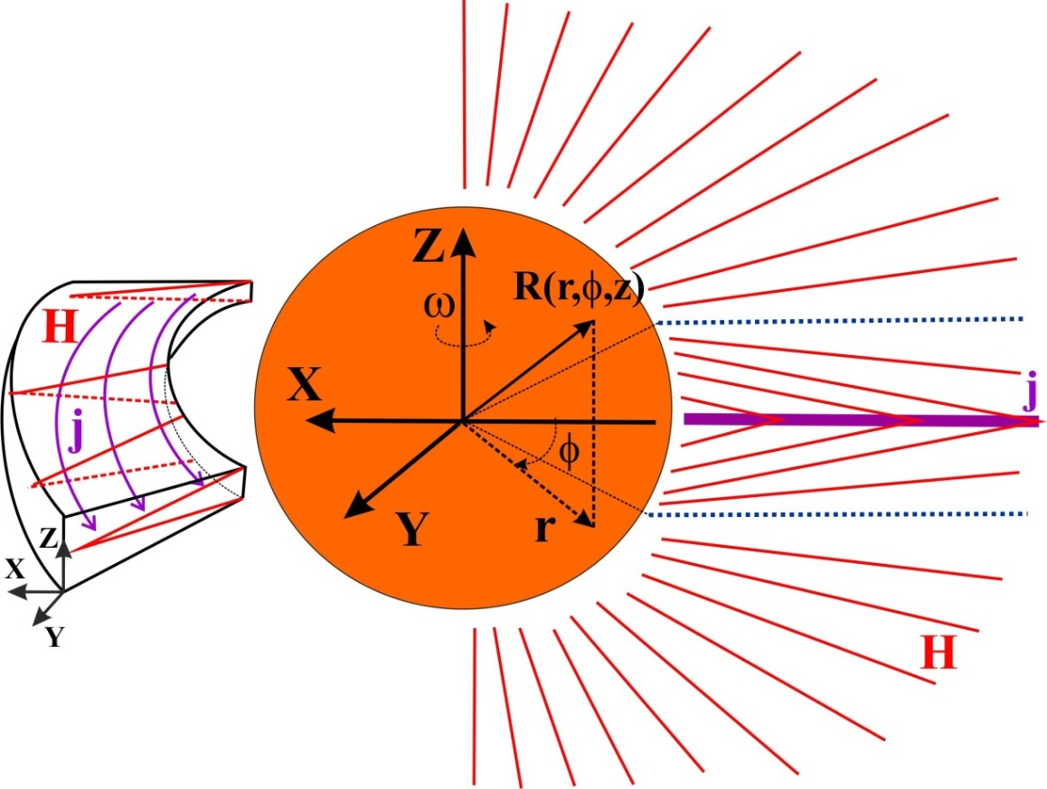


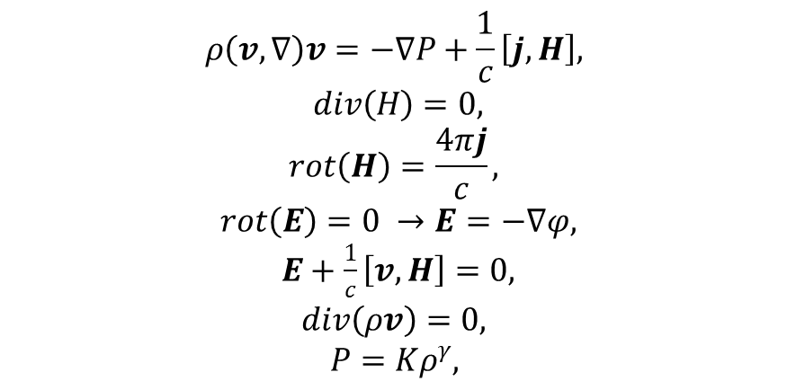
The model
,
Axial symmetry
Monotonically in z coordinate
Thin HPS
k<<1
Superalfvenic flow
Polytrophic index γ=1 or 5/3

Slide 8
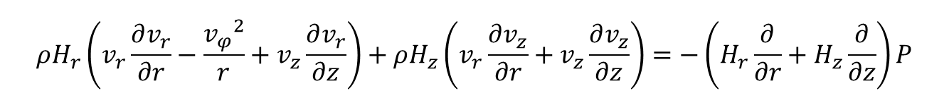
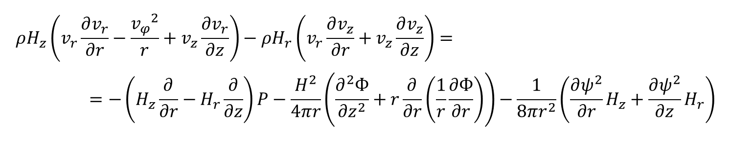
Plasma equilibrium in projections
$$ρH_{r}\left(v_{r}\frac{∂v_{r}}{∂r}−\frac{{v_{φ}}^{2}}{r}+v_{z}\frac{∂v_{r}}{∂z}\right)+ρH_{z}\left(v_{r}\frac{∂v_{z}}{∂r}+v_{z}\frac{∂v_{z}}{∂z}\right)=−\left(H_{r}\frac{∂}{∂r}+H_{z}\frac{∂}{∂z}\right)P$$
$$ρH_{z}\left(v_{r}\frac{∂v_{r}}{∂r}−\frac{{v_{φ}}^{2}}{r}+v_{z}\frac{∂v_{r}}{∂z}\right)−ρH_{r}\left(v_{r}\frac{∂v_{z}}{∂r}+v_{z}\frac{∂v_{z}}{∂z}\right)==−\left(H_{z}\frac{∂}{∂r}−H_{r}\frac{∂}{∂z}\right)P−\frac{H^{2}}{4πr}\left(\frac{∂^{2}Ф}{∂z^{2}}+r\frac{∂}{∂r}\left(\frac{1}{r}\frac{∂Ф}{∂r}\right)\right)−\frac{1}{8πr^{2}}\left(\frac{∂ψ^{2}}{∂r}H_{z}+\frac{∂ψ^{2}}{∂z}H_{r}\right)$$

Slide 9
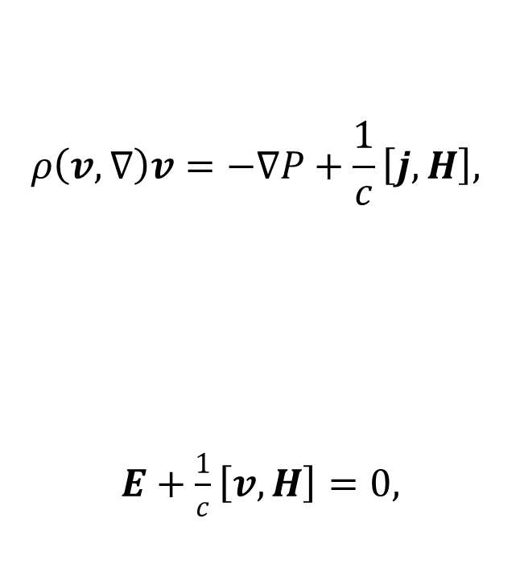

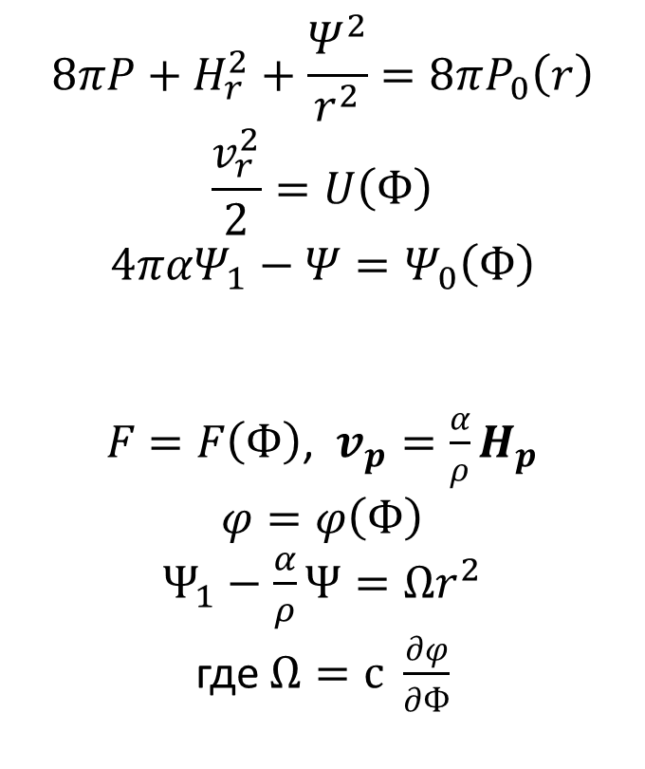
Solutions
$Ф_{0}(r)$, $P_{0}(r)$при$z=0,α$, $Ω$, $U$, $Ψ_{0}$
$$ρ\left(v,∇\right)v=−∇P+\frac{1}{c}\left[j,H\right],$$
$$E+\frac{1}{c}\left[v,H\right]=0,$$
$$8πP+H_{r}^{2}+\frac{Ψ^{2}}{r^{2}}=8πP_{0}\left(r\right)$$
$$\frac{v_{r}^{2}}{2}=U\left(Ф\right)$$
$$4παΨ_{1}−Ψ=Ψ_{0}\left(Ф\right)$$
$F=F\left(Ф\right)$, $v_{p}=\frac{α}{ρ}H_{p}$
$$φ=φ\left(Ф\right)$$
$$Ψ_{1}−\frac{α}{ρ}Ψ=Ωr^{2}$$
где $Ω=с \frac{∂φ}{∂Ф}$
1
2
3
4
5
6
Pressure balance
“Bernoulli” equation
Total current is not only flux function
Mass flux along the magnetic lines
The magnetic lines are equipotential
Ferraro isorotation is not applicable in case of significant poloidal velocity.
Notes:
$−с^{−1}Ω∇Ф$ – эл.поле

Slide 10
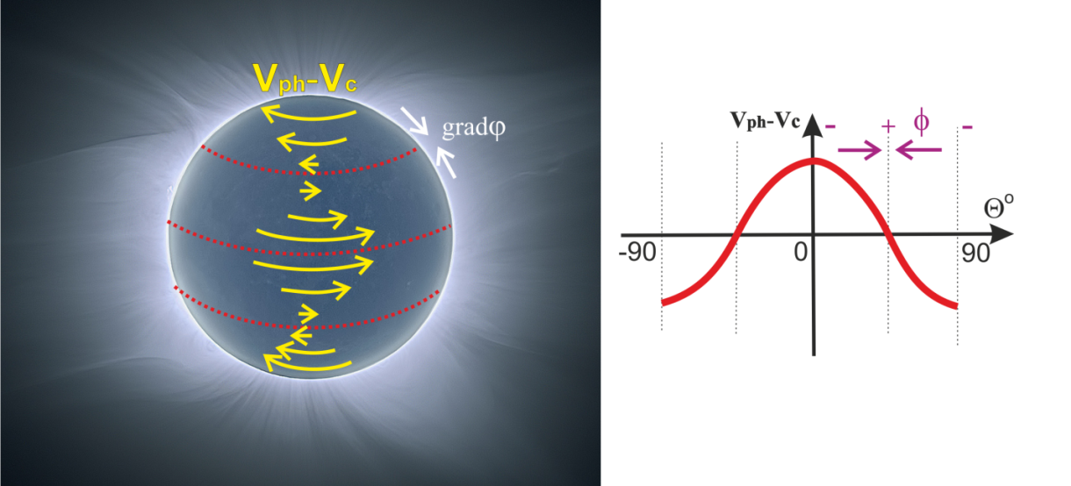


Unipolar generation in the corona
In the internal corona conductivity is finite but the boundary is determinated as place where conductivity is infinite:
On the boundary is correct “non-Ferraro” equation, so
The solution:

Slide 11
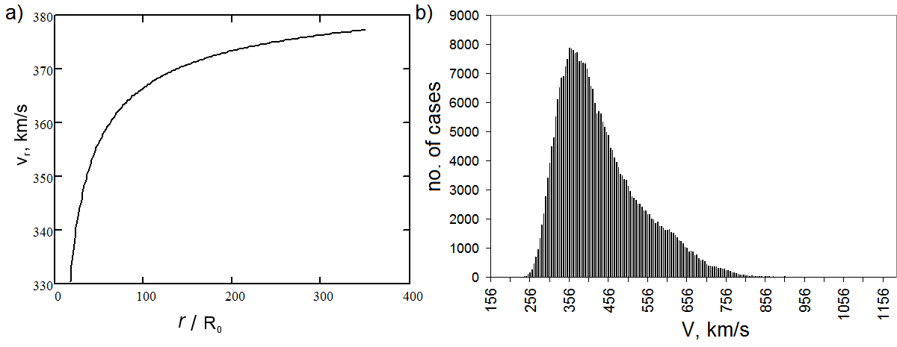
Speed at 1 AU (1AU=215R₀)
The radial dependence of the solar wind speed. (a) the modeling result in the neutral plane (z=0); (b) the solar wind speed distribution at 1 AU from OMNI2 database.

Slide 12
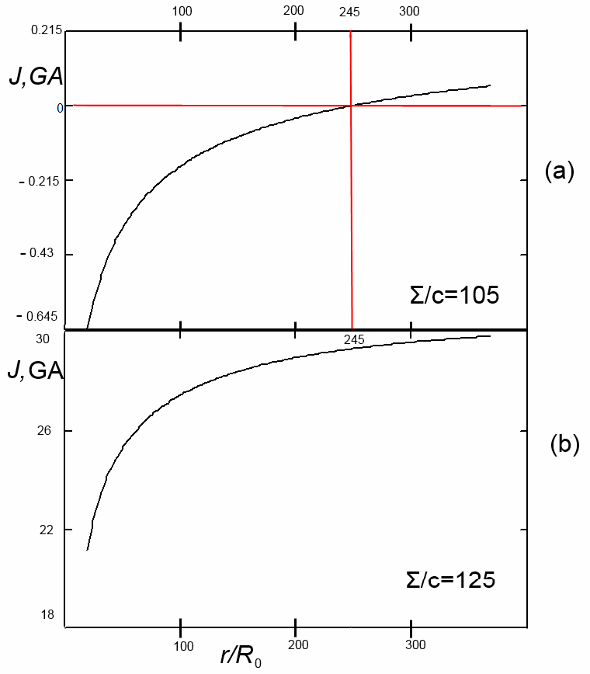
Total HCS’s current. Returning point
Fig. 5. The cumulative current through the HCS for(a) and for (b). The returning point is shown with crossed red lines.

Slide 13
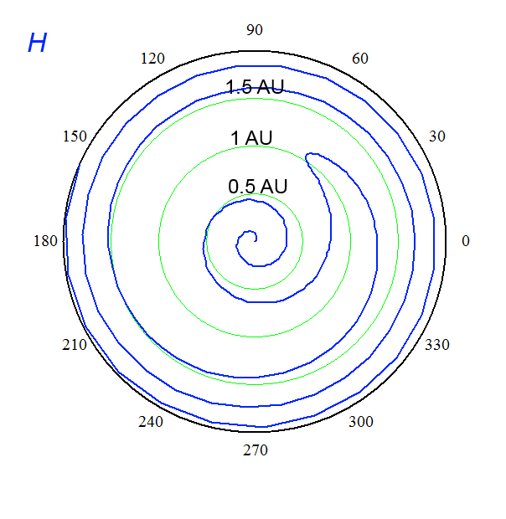
Non-Parker Spiral
Calculated magnetic field line directions (blue) along the HCS.
Notes:
Совпадают на удалении

Slide 14
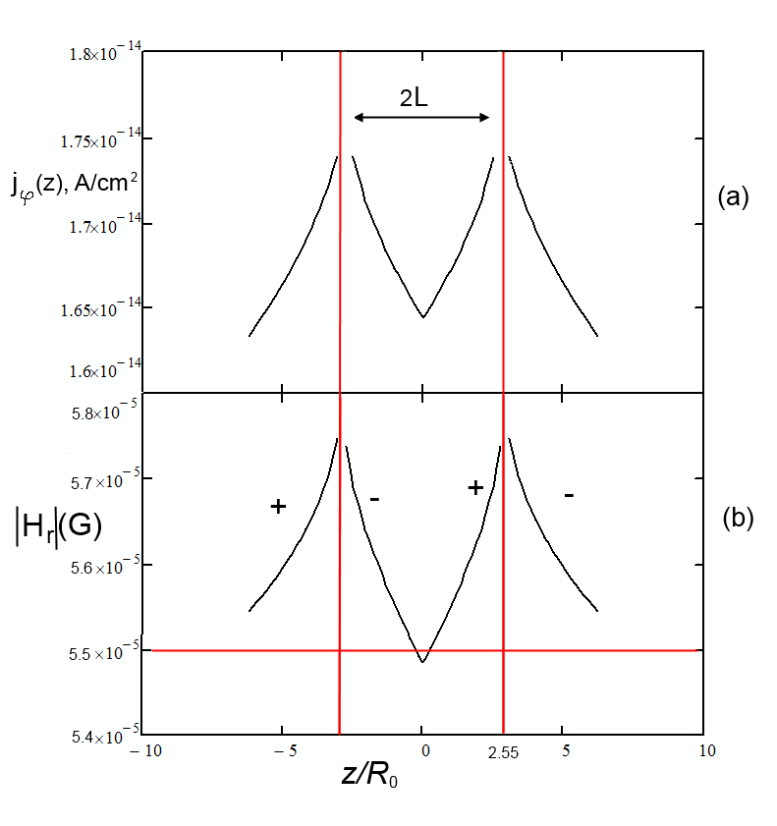
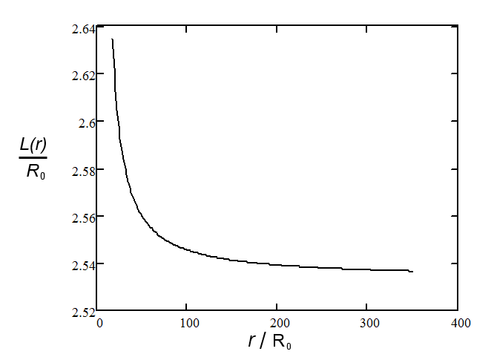
Azimutal current density, radial field, separatrixes, thickness
Variations of the azimuthal electric current density (a) and the absolute value of the radial magnetic field (b) at along the normal to the HCS (Z) direction. The red lines indicate separatrices. The horizontal red line in (b) indicates minimal level of the field upon the separatrices at Z much more than the thickness. Pluses and minuses indicate a sign of H_{r} function. L is the HPS thickness.

Slide 15
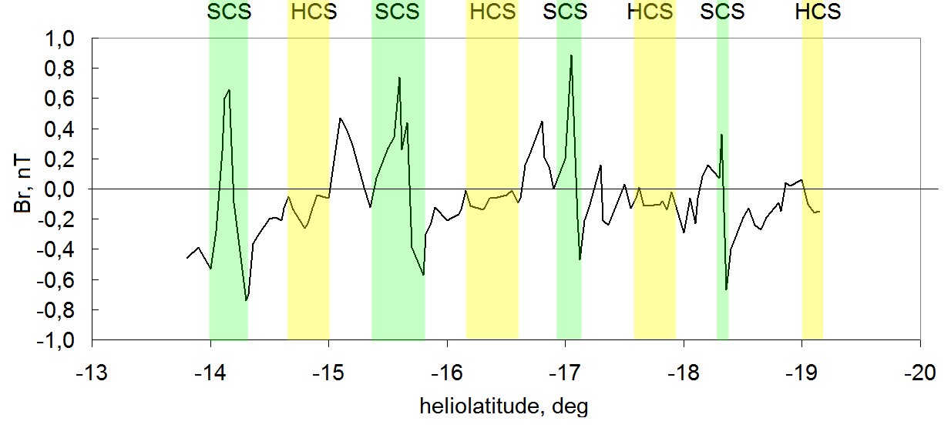
Comparison with the experiment. Separatrix current sheets (SCS)
The vertical cutoff of the HCS-HPS structure as seen from daily averaged Ulysses data for the vertical component of the IMF. The periodic structure corresponds to crossings of the HPS separatrices (separatrix current sheets - SCSs) and the HCS between them

Slide 16
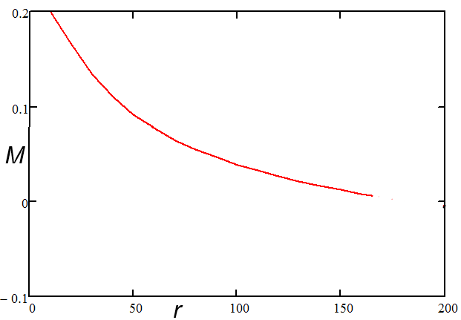
There is no corotation
Mass density of the angular momentum

Slide 17
Conclusion
1) Radial speed in agreement with observations
2) The cumulative (integrated) electric current in the HCS-HPS system significantly depends on the height-integrated conductivity of the solar corona.
3) The existence of a turning point at distances about 245
4) The total current makes tens of hundreds of MA in the presence of a turning point, and may reach severaltens of GA without it. The total ring current makes about 25 GA within the HPS
5) The thickness of the HPS weakly depends on distance and is about 2.5 solar radii.
6) The boundary of the HPS represents two separatrices wih strong SCS currents
7) There is no significant co-rotation of the solar wind plasma.
8) Observations confirm the existence of sharp boundaries of the HPS – separatrices. The separatrices represent two additional current sheets surrounding the HCS. Periodic boundary conditions may producethe recurrent profile of the IMF radial component across the HCS-HPS system observed by Ulysses at 5.3 AU.

Slide 18
Thank you for attention!

