Slide 1
INTERPLANETARY CUBESAT NAVIGATIONAL CHALLENGES
Tomas J. Martin-Mur, Eric D. Gustafson, and Brian T. Young
Jet Propulsion Laboratory, California Institute of TechnologyPasadena,
Abstract: CubeSats are miniaturized spacecraft of small mass that comply with a form specification so they can be launched using standardized deployers. Since the launch of the first CubeSat into Earth orbit in June of 2003, hundreds have been placed into orbit. There are currently a number of proposals to launch and operate CubeSats in deep space, including MarCO, a technology demonstration that will launch two CubeSats towards Mars using the same launch vehicle as NASA’s Interior Exploration using Seismic Investigations, Geodesy and Heat Transport (InSight) Mars lander mission. The MarCO CubeSats are designed to relay the information transmitted by the InSight UHF radio during Entry, Descent, and Landing (EDL) in real time to the antennas of the Deep Space Network (DSN) on Earth. Other CubeSat proposals intend to demonstrate the operation of small probes in deep space, investigate the lunar South Pole, and visit a near Earth object, among others. Placing a CubeSat into an interplanetary trajectory makes it even more challenging to pack the necessary power, communications, and navigation capabilities into such a small spacecraft. This paper presents some of the challenges and approaches for successfully navigating CubeSats and other small spacecraft in deep space.

Slide 2
CubeSats are miniaturized spacecraft of small mass that comply with the CubeSat Design Specification published by the CubeSat Program (Cal Poly) at the California Polytechnic State University, San Luis Obispo. Started in 1999, the CubeSat Project began as a collaborative effort between Prof. Jordi Puig-Suari at Cal Poly, and Prof. Bob Twiggs at Stanford University's Space Systems Development Laboratory (SSDL). The purpose of the program is “to provide a standard for design of picosatellites to reduce cost and development time, increase accessibility to space, and sustain frequent launches.” [1] Currently more than 100 universities, high schools, and other private and public entities are developing CubeSats for a wide number of applications. The most basic CubeSat (1U) is a 10 cm cube with a mass of up to 1.33 kg, but they are scalable in 1U increments with 2U and 3U models having been built and launched, and 6U and 12U models, some exceeding the scaled maximum mass, having been proposed.

Slide 3
A number of deep space or interplanetary CubeSat flight demonstrations and missions have been proposed or at different stages of development, both at NASA and by other space agencies. [2] The goals of these missions go from demonstrating CubeSat technology and capabilities for deep space use to performing scientific research at different solar system locations and bodies. The perceived advantage of using CubeSats is that they are cheaper to build and launch than bigger spacecraft, and they can be built faster when taking advantage of standard CubeSat components and subsystems available in the marketplace. There are a number of opportunities to launch CubeSats along with bigger spacecraft, making use of excess launch capability, and there are also proposals for the CubeSats to hitch a ride with other spacecraft and to be deployed when the main spacecraft reaches its destination. The first Space Launch System (SLS) mission, Exploration Mission 1 (EM-1) – currently scheduled to launch in 2018 – will deploy 11 CubeSats after it deploys Orion into a translunar trajectory. Three of these CubeSat concepts have already been selected as of the writing of this paper: Lunar Flashlight, [3] Near-Earth Asteroid Scout, [4] and BioSentinel, [4] and other selections may include participation by non US-government partners.

Slide 4
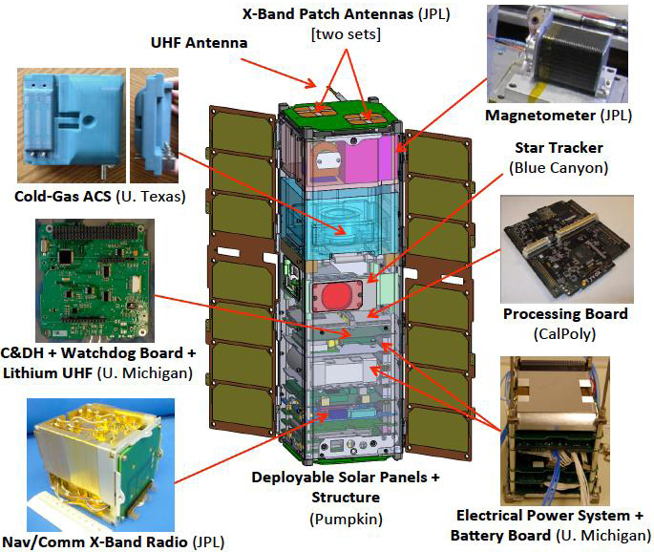
Figure 1. INSPIRE Overview (NASA/JPL)
The INSPIRE probes were completed in 2014 and are currently waiting for a suitable launch opportunity.

Slide 5
The first CubeSat probes built for deep space are the Interplanetary NanoSpacecraft Pathfinder In Relevant Environment (INSPIRE). [6] This NASA/JPL mission addresses a tiered set of technology demonstration and education objectives, including a demonstration that CubeSats can operate, communicate, and navigate far from Earth. The flight system comprises two identical 3U CubeSats with three-axis attitude control using a star tracker and a cold-gas reaction control system. The probes use DSN-compatible IRIS v1 radios [7] for X-band communication and tracking. The IRIS radio, developed by the NASA Jet Propulsion Laboratory, is a miniaturized DSN-compatible radio capable of coherent 2-way Doppler, ranging, and Differential One-way Ranging (DOR) tones. It occupies about 0.5U, weighs about 0.5 Kg and requires about 13 W of power when receiving and transmitting.

Slide 6
For INSPIRE, the radio will operate in X-band, but future versions of the radio could be setup for Ka-band, S-band, or UHF operations. The INSPIRE probes are equipped with dual receive / transmit patch antennas for communication with the DSN stations, limiting the distance at which the radio can communicate with the ground due the available transmit power. It is expected that a telemetry rate of 1 kbps can be demonstrated at a distance of 1.5M km. The radio performance should be sufficient to demonstrate a navigational accuracy of better than 500 km when relatively close to the Earth, and between 1000 and 2000 km at greater distances, using 2-way Doppler and range.

Slide 7
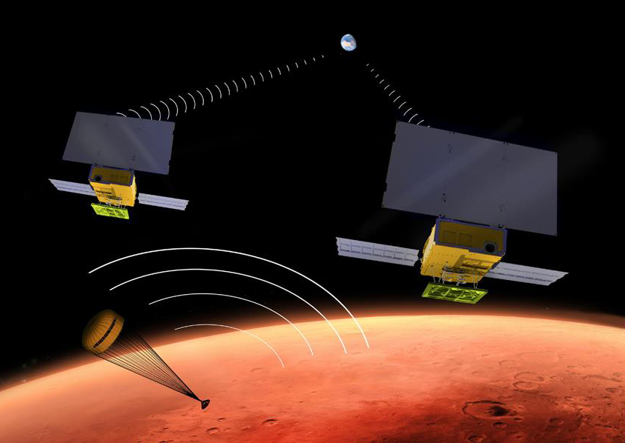
Figure 2. Artist’s Concept for MarCO (NASA/JPL)
The MarCO probes will be flown independently of InSight, and success of their demonstration is not needed for InSight mission success. The probes will be equipped with a cold-gas propulsion system for attitude and trajectory control, and with an IRIS v2 radio capable of X-band receive and transmit and of UHF receive. During InSight’s Entry, Descent, and Landing (EDL), the MarCO probes will receive and decode the 8 kbps UHF signal generated by InSight and transmit the decoded data to the Earth in X-band. The probes will have a deployable X-band transmit array to ensure that their signal will be strong enough to be received by the DSN 70m antenna in Madrid. Up to five Trajectory Correction Maneuvers (TCMs) are planned in order to remove the injection bias and error, ensure compliance with planetary protection requirements, and achieve the final fly by trajectory to ensure a successful EDL relay, all while maintaining a safe separation distance with respect to InSight and each other.

Slide 8
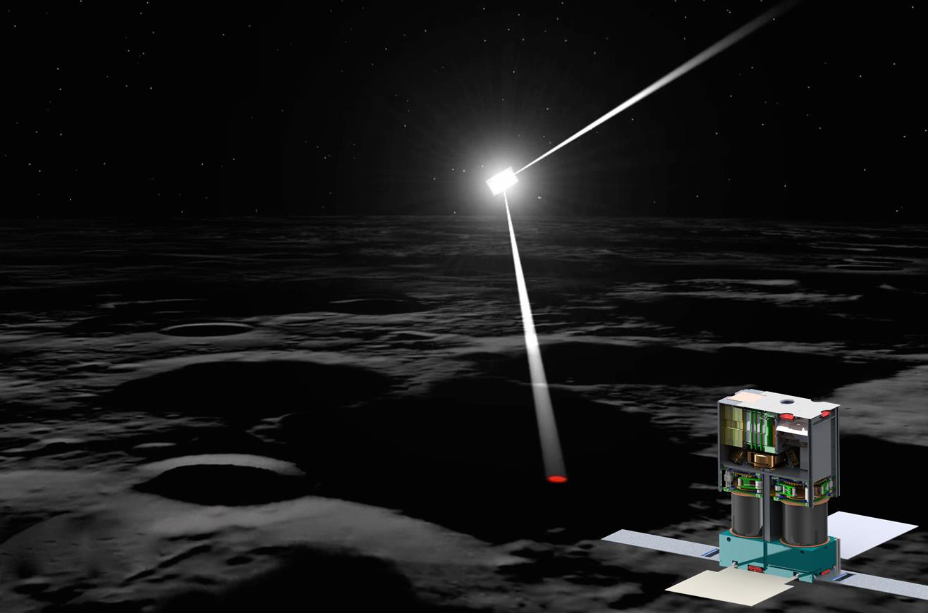
Figure 3. Artist’s Concept for Lunar Flashlight (NASA/JPL)
In its current configuration, Lunar Flashlight would be equipped with an 80 m2 solar sail to propel the probe and to reflect sunlight into permanently shadowed regions of the Moon’s surface. The probe would be equipped with an IRIS v2 radio for communications and navigational tracking.

Slide 9
The Near Earth Asteroid Scout (NEAScout) [4] is a NASA/JPL/MSFC 6U CubeSat also manifested for the EM-1 SLS launch. It intends to be the first CubeSat to reach an asteroid and it would map the asteroid and demonstrate a number of innovative technologies. In its current concept, it is equipped with an 80 m2 solar sail similar to that in Lunar Flashlight, but instead of maneuvering into a lunar orbit, it would escape from the Earth/Moon system in order to rendezvous with an asteroid for a slow flyby. The probe would also be equipped with and IRIS v2 radio for communications and navigational tracking, and would stay within 1 AU of the Earth due to be able to maintain communications with the DSN. During approach the probe would use an optical camera to assist with navigation relative to the asteroid.

Slide 10
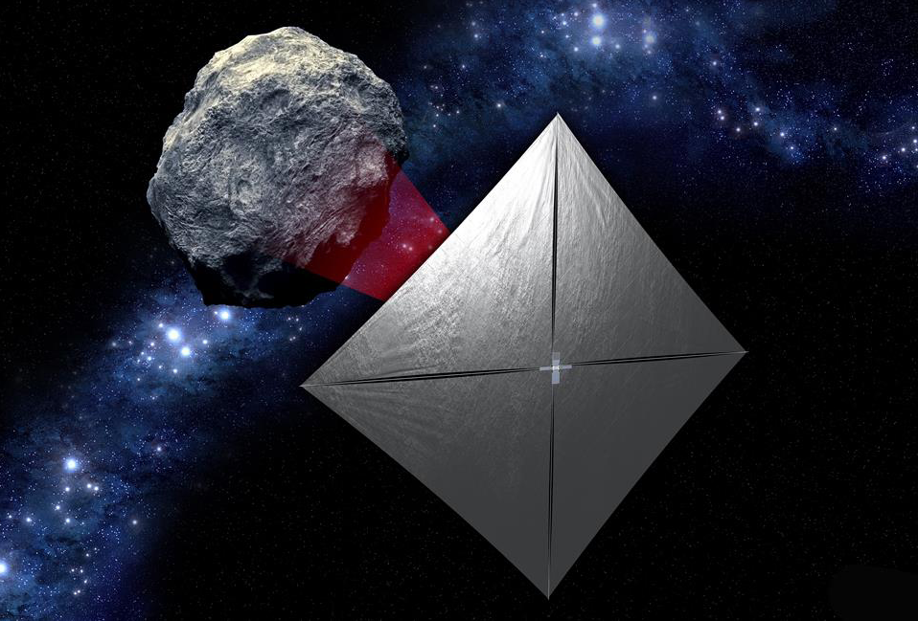

Slide 11
The Challenges of Deep Space CubeSat Navigation
Flying spacecraft in general is challenging; flying small spacecraft in Earth orbit is even more challenging because of the limitations imposed by the small spacecraft mass and volume. As CubeSats push the boundaries of their capabilities, the challenges become more difficult, and the difficulties are compounded when flying a CubeSat into deep space because it is even more challenging to pack the needed power, communications, and navigation capabilities into such a small spacecraft. Deep-space communications require both a large ground antenna and a communications system in the spacecraft with sufficient receive and transmit gain and transmit power. The small size of CubeSats limits the size of the solar panels, and consequently the power that they can produce, and also the size of the communication antennas.

Slide 12
The CubeSat paradigm is a very attractive option for low-cost interplanetary missions, but it presents some specific challenges on top of those already faced by bigger deep-space spacecraft. In particular, we have described the navigation challenges faced by CubeSats in terms of energy management, propulsion, tracking, and planetary protection, but there are also significant challenges in other areas, including thermal management and communications. While CubeSats may be cheaper to build and launch, mission operations may not necessarily be cheaper if the requirements and constraints imposed on the CubeSat mission are similar to those imposed on missions using bigger spacecraft.

Slide 13
INTEGRAL End-Of-Life Disposal Manoeuvre Campaign
C. Dietze, A. Vasconcelos, G. Ziegler, A. McDonald, R. Southworth
European Space Agency (ESA), ESOC, Robert-Bosch-Str. 5, 64293 Darmstadt, Germany,
Abstract: Gamma-ray observatory INTEGRAL is in an highly eccentric orbit and due to demand has been extended well beyond its nominal lifetime of 2.5+2.5 years. The initial 3 sidereal day orbit provided long periods of uninterrupted observation and continuous ground station support outside of Earth’s radiation belts. Natural orbit evolution due to luni-solar perturbations causes variations in the perigee altitude leading to repeated crossings of the protected GEO and LEO regions in the next 200 years. An analysis of disposal options recommended the execution of an apogee lowering manoeuvre in 2015 leading to re-entry in early 2029 via third body perturbations. In 2014 a target orbit acceptable for future operations was derived, fulfilling debris-avoidance requirements and maximizing station coverage outside the radiation belts. A manoeuvre campaign was designed considering all requirements regarding operations, spacecraft safety and maximal science observation time. The month-long campaign was executed beginning of 2015. This paper describes the preparatory analyses, manoeuvre execution and subsequent operations from Flight Dynamics point of view, and summarises the current status.

Slide 14
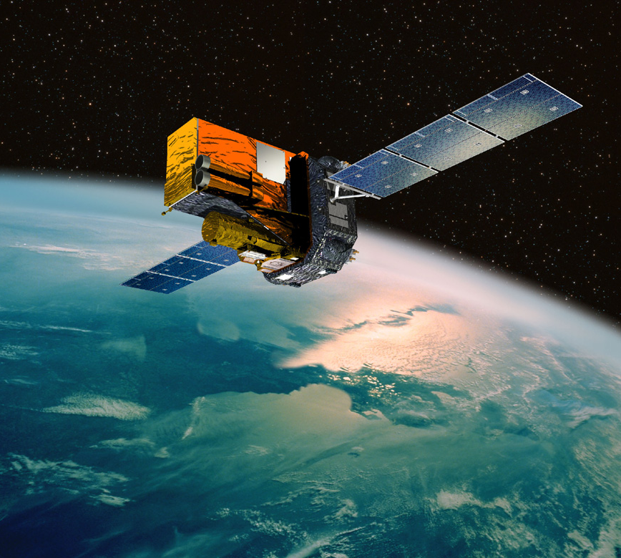

Slide 15
ESA's INTErnational Gamma-Ray Astrophysics Laboratory (INTEGRAL) is the most sensitive observatory in the hard X-ray to soft gamma-ray range and is operated from the European Space Operations Centre (ESOC), Darmstadt, Germany. Launched in October 2002 the mission was designed for a nominal lifetime of 2.5 years with a possible extension of another 2.5 years. Due to the accurate orbit insertion (large fuel reserve), flawless performance of the platform and instruments as well as continued high scientific interest the mission has regularly been extended, currently up to end of 2018 (subject to a review in 2016). The spacecraft was launched from Baikonur, Kazakhstan, into a highly eccentric orbit of 9,050 perigee and 153,660 km apogee altitude with an inclination of 52.25 degrees. This 3 sidereal day orbit ensured a repeating ground station pattern and the chosen phasing with respect to the Earth guaranteed continuous coverage originally from the Redu and since December 2013 from the Kiruna ground station for spacecraft heights above the Earth radiation belts. This is required due to the lack of data storage on-board: the scientific data - recorded continuously outside of the radiation belts - need to be sent instantaneously to ground or they are lost. Furthermore, the repeating event pattern eases mission planning, i.e. scheduling of scientific observations and platform operations, which is done on a revolution basis for INTEGRAL.

Slide 16
Choice of Repeat Orbit
Possible orbits with an apogee radius below the disposal apogee radius and with a period corresponding to a repeat orbit were analysed. The results are summarized in ascending delta-v order in Tab. 1. The perigee radius is assumed to be ~15,100 km both before and after the manoeuvre planned for January 2015.
The solution of 3 revolutions in 8 days (“3/8 repeat orbit”) was selected. This is the repeat pattern with the least number of cases (shortest repeat cycle), thus being simpler for mission planning. In addition, the required delta-v to achieve that orbit is the closest to the minimum delta-v for disposal, increasing the lifetime of the spacecraft in terms of fuel when compared with the other solutions.

Slide 17
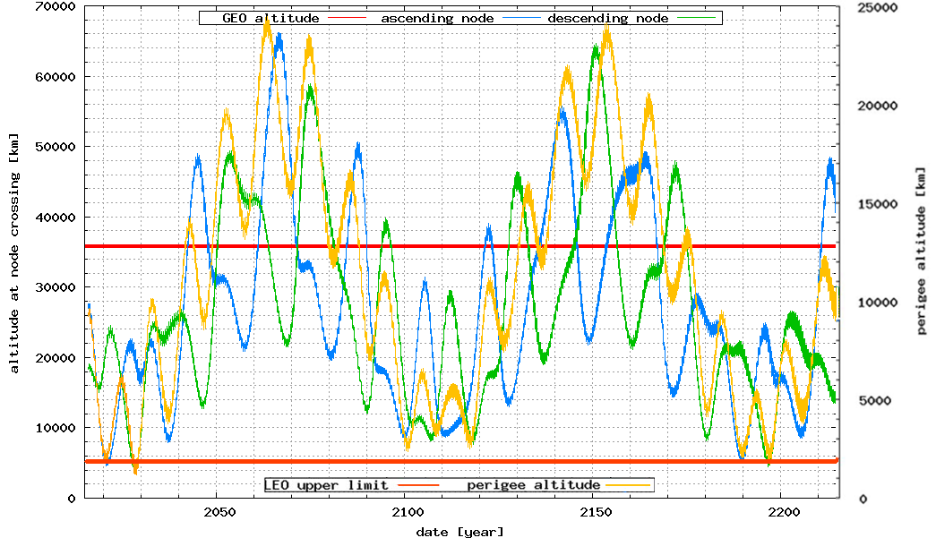

Slide 18
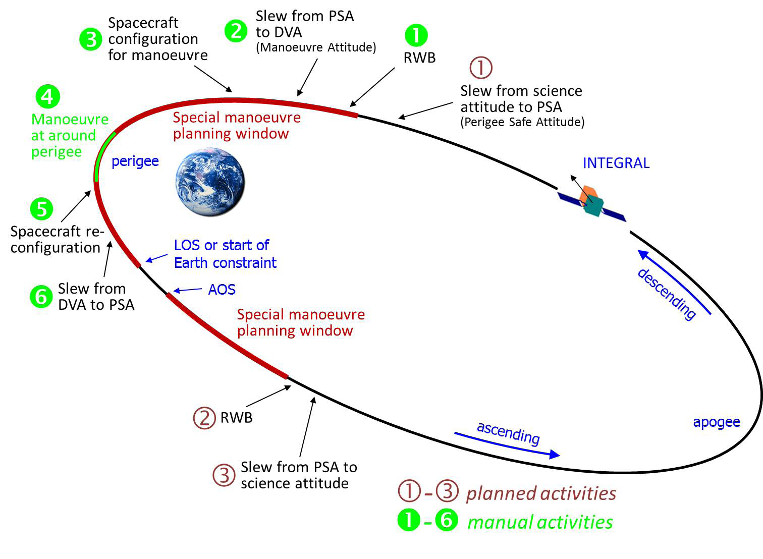

Slide 19
The final achieved orbit was analysed by ESOC’s Space Debris Office assuming that the 3/8 repeat pattern is kept and the longitude of perigee at every third orbit is at 105 +/-5 degrees. The long-term propagation shows that the re-entry of INTEGRAL will occur at the end of February 2029. A dedicated breakup analysis shows a minimal on-ground casualty risk due to the southern impact latitude range.
The underperformance of manoeuvre 1 caused an increase of the estimated propellant usage by ca. 3 kg. After the disposal campaign approximately 47.8 kg of fuel were left, which at the current average rate of consumption would support further operations up to October 2021. If other factors, like power or fiscal constraints, limit the spacecraft’s lifetime, the remaining propellant could be used to ‘trim’ the orbit in order to better constrain the re-entry conditions and thereby further reduce the on-ground expected casualty risk

Slide 20
FORMATION DESIGN ANALYSIS FOR A MINIATURIZED DISTRIBUTED
OCCULTER/TELESCOPE IN EARTH ORBIT
Adam W. Koenig, Simone D’Amico, Bruce Macintosh, and Charles J. Titus Stanford University, Department of Aeronautics & Astronautics, Space Rendezvous Laboratory,
Durand Building, Stanford University, Department of Physics
Abstract:
This paper extends a recently proposed formation design methodology for a miniaturized distributed occulter/telescope (mDOT). In contrast to large-scale missions such as the New Worlds Observer or Exo-S (NASA), mDOT makes use of micro- and nano-satellites inertially aligned earth orbit to reduce mission costs by orders of magnitude. Due to the small telescope aperture, this concept requires greater instrument integration time (or observation duration) in an environment with larger differential accelerations. Consequently, a delta-v optimal design of the absolute and relative orbits represents a mission enabler. The proposed formation design strategy stems from the fundamental idea that the delta-v cost of observations can be minimized by allowing the formation to freely drift along the line-of-sight. This paper makes two key contributions to the state of the art. First, it is demonstrated through high-fidelity numerical simulations that third body, solar radiation pressure, and atmospheric drag forces have negligible impact on the delta-v cost of mission operations. Second, the cost associated with a reference mission is characterized as a function of the location of the science target. This characterization is performed with and without a constraint that observations are performed with the occulter spacecraft in earth’s umbra. This constraint ensures that light reflected by the occulter does not overwhelm the signal from the science
target.

Slide 21
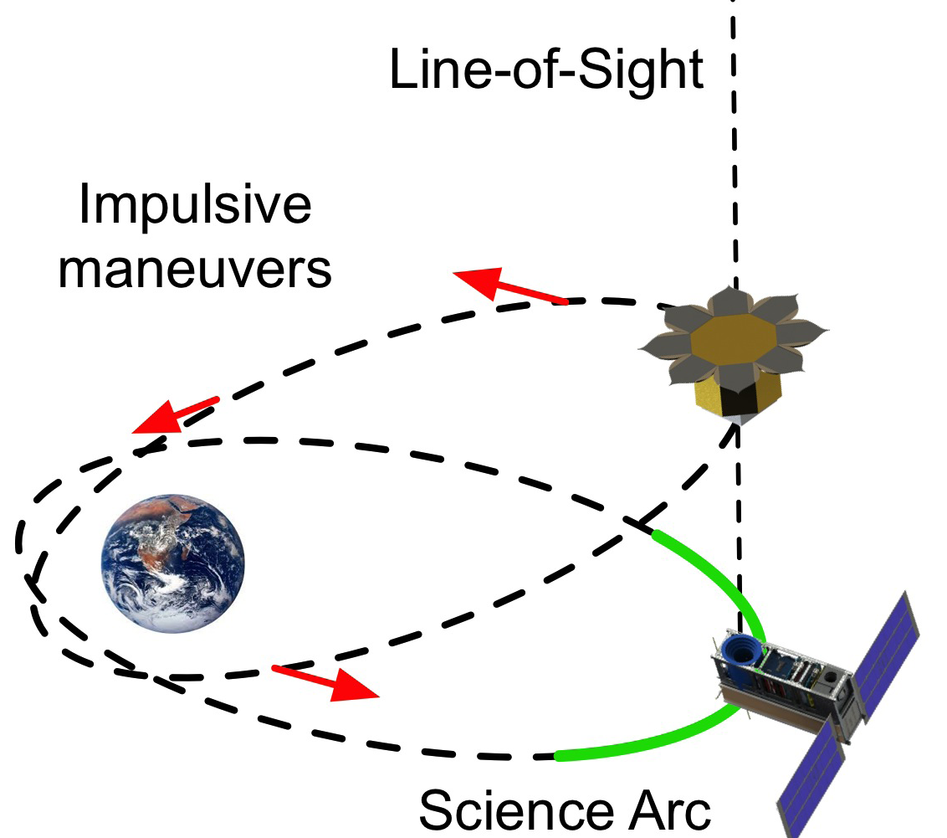

Slide 22
Overall, this paper demonstrates that deployment of a miniaturized distributed occulter/telescope on micro- or nano-satellites in earth orbit to image an exozodiacal dust disk is feasible with current propulsion technology provided that the absolute and relative orbits are properly selected. Deployment of such a mission could demonstrate the validity of the distributed occulter/telescope concept and provide a valuable science return at a small fraction of the cost of large-scale platforms

Slide 23
LOW-THRUST TRAJECTORY DESIGN AND OPERATIONS OF PROCYON, THE FIRST DEEP-SPACE MICRO-SPACECRAFT
Stefano Campagnola, Naoya Ozaki, Yoshihide Sugimoto, Chit Hong Yam, Hongru Chen, Yosuke Kawabata, Satoshi Ogura, Bruno Sarli, Yasuhiro Kawakatsu, Ryu Funase, and Shinichi Nakasuka
Abstract: PROCYON is the first deep-space micro-spacecraft; it was developed at low cost and short time (about one year) by the University of Tokyo and JAXA, and was launched on December 3rd, 2014 as a secondary payload of the H-IIA launch of Hayabusa2. The mission primary objective is the technology demonstration of a micro-spacecraft bus for deep-space exploration; the second objectives are several engineering and science experiments, including an asteroid flyby. This paper presents PROCYON high-fidelity, very-low-thrust trajectory design and implementation, subject to mission and operation constraints. Contingency plans during the first months of operations are also discussed. All trajectories are optimized in high-fidelity model with jTOP, a mission design tool first presented in this paper. Following the ion engine failure of March 2015, it was found the nominal asteroid could not be targeted if the failure was not resolved by mid-April. A new approach to compute attainable sets for low-thrust trajectories is also presented.

Slide 24
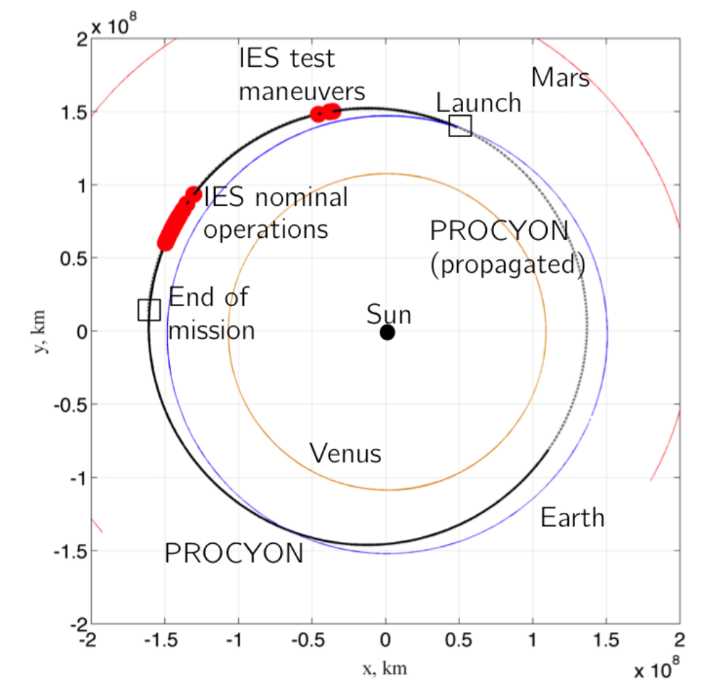

Slide 25
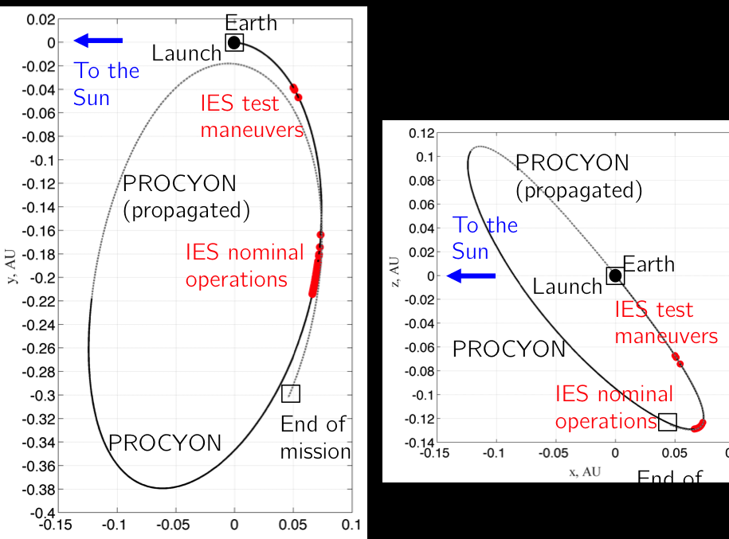

Slide 26
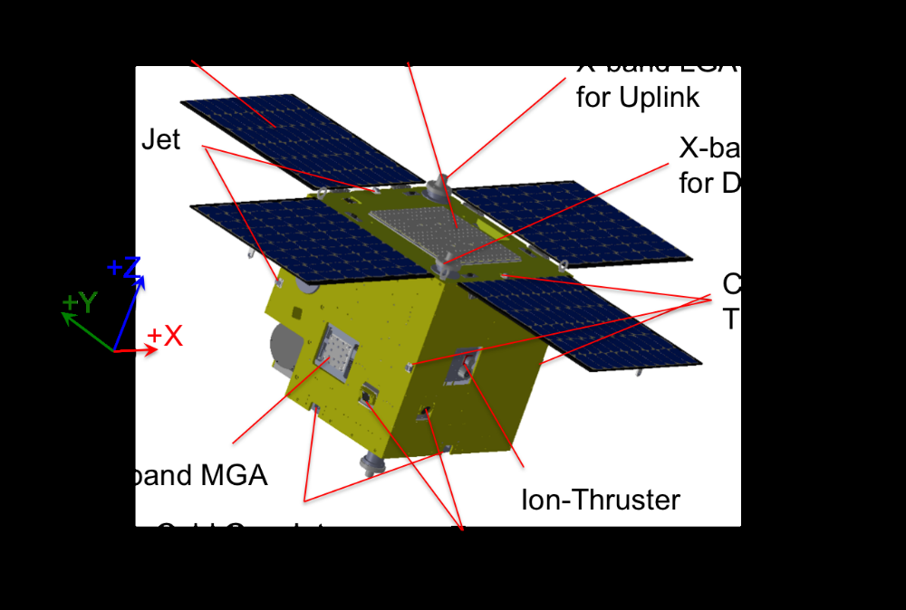

Slide 27
Structure Size 0.55m x 0.55m x 0.67m
+ 4 SAPs
Weight 66.9 (Wet)
Power SAP Triple Junction GaAs¿240W
(1AU,as = 0,BOL)
BAT Li-ion, 5.3Ah
AOCS Actuator 4 Reaction Wheels,
3-axis Fiber Optic Gyro
Sensor Star Tracker, Non-spin
Sun Aspect Sensor.
Telescope (for opt. nav. )
Prop. RCS Xenon CGJ x8,
˜22mN thrust, 24s Isp
Ion Propulsion Xenon microwave
discharge ion prop. system
0.3 mN thrust, 1000s Isp
Propellant 2.5 kg Xenon
Comm. Frequency X-band
Antenna HGAx1, MGAx1, LGAx2
(for UL), LGAx2 (for DL)

Slide 28
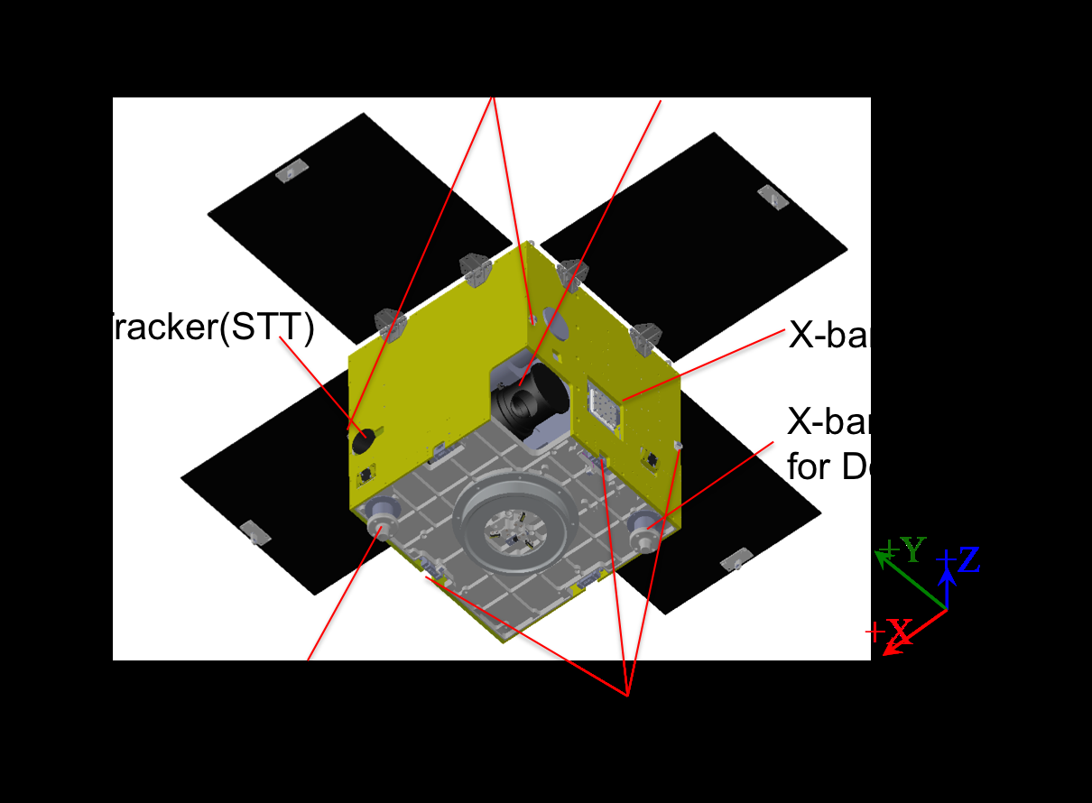

Slide 29
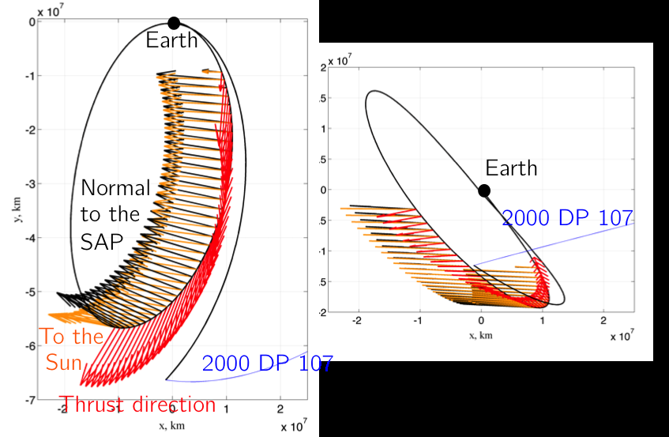

Slide 30
COLLISION AVOIDANCE STRATEGIES, IMPLEMENTATION AND OPERATIONAL EXPERIENCE FOR DEIMOS-1 AND DEIMOS-2 MISSIONS
Mar Luengo Cerrón(1), Carlos Díaz Urgoiti(2), Fernando Gonzalez Meruelo(3), Annalisa Mazzoleni(4), Patricia Pisabarro Marrón(5), Fabrizio Pirondini
Abstract: Deimos Imaging (Spain), a subsidiary of UrtheCast Corp. (Canada), owns two commercial Earth Observation (EO) missions, DEIMOS-1 and DEIMOS-2. Deimos Imaging is in charge of operating both satellites and commercialising their imagery. Launched in 2009, DEIMOS-1 is a 100-kg satellite based on SSTL-100 platform equipped with a warm-gas resistojet, and currently at the beginning of its 5-year extended lifetime. Launched in mid-2014, DEIMOS-2 is a 300-kg satellite based on Satrec Initiative SpaceEye-1 platform equipped with a low-thrust Hall-Effect plasma thruster. Both missions fly on Sun-Synchronous Low Earth Orbit (LEO), with mean altitudes of 660 km for DEIMOS-1 and 620 km for DEIMOS-2. This orbit environment is known for its high density of operational and non-operational objects, and thus an efficient Collision Avoidance (CA) procedure is of key importance to assure the survivability of each mission. This paper presents an overview of Deimos Imaging Collision Avoidance activities, based on the operational experience for DEIMOS-1 and DEIMOS-2 missions. Operational tools, theories and procedures used are outlined, aided by real-life examples of conjunction events.

Slide 31
DEIMOS-1 and DEIMOS-2 missions are fully owned and operated by Deimos Imaging (Spain), a subsidiary of UrtheCast Corp. (Canada). Successfully launched in July 2009, the DEIMOS-1 satellite is currently at the beginning of its 5-year extended lifetime, while the DEIMOS-2 satellite, launched in June 2014, is at the beginning of its 10 years of expected lifetime.
DEIMOS-1 is equipped with a multi-spectral optical instrument, having a spatial resolution of 22 m and a very wide swath of 650 km. Its imagery is mainly used for large-scale agriculture applications worldwide. DEIMOS-2 is an agile 300-kg satellite for very-high-resolution Earth Observation applications. It provides 75-cm pan sharpened images with a swath of 12 km at nadir, mainly for mapping, monitoring and security applications.

Slide 32
Both satellites are equipped with a propulsion system providing thrust in the millinewton range, with a specific impulse around 100 s for DEIMOS-1 (warm-gas resistojet), and 1000 s for DEIMOS-2 (Hall Effect Thruster). They both underwent a large orbit manoeuvring campaign just after launch, aimed at reaching the nominal operational altitude and ensuring an optimal natural (uncontrolled) evolution of the Local Time at Ascending Node (LTAN). After these initial campaigns had been successfully carried out, the activities of the Flight Dynamics (FD) team are centred on collision avoidance issues.
Both missions fly on Sun-Synchronous LEO, with mean altitudes of 660 km for DEIMOS-1 and 620 km for DEIMOS-2. This orbit environment is quite littered with space debris, and an efficient Collision Avoidance (CA) procedure is of key importance for assuring the survivability of each mission. In order to maximise the effectiveness of the CA, Deimos Imaging FD team is in constant communication with the Joint Space Operations Center (JSpOC). The need to give a quick and sensible

Slide 33
answer to Conjunction Data Messages (CDMs) received from JSpOC drove the creation of the internal tools and operational procedures which are now the backbone of Deimos Imaging CA strategy.
A first set of tools, aimed at anticipating possible close approaches by using multiple TLEs to refine the orbit of an object, provide quick results and help the operators to easily assess the characteristics of any possible close approach. Additionally, tools to compute the collision probability and geometry at the B-plane based on CDM data are also available and used in actual operations to ease the decision-making process. Besides, tools implementing the latest developments in algorithms to create avoidance strategies are used to cross-check and refine the avoidance strategy. Finally, visualization and data-distribution tools are continuously being improved to guarantee that relevant information is made available to the appropriate people in a clear and concise manner. This paper presents an overview of Deimos Imaging Collision Avoidance activities, based on the operational experience for DEIMOS-1 and DEIMOS-2 missions. Operational tools, theories and procedures used are outlined, aided by real-life examples of conjunction events of conjunction events.

Slide 34
ASTEROID’S ORBIT AND ROTATIONAL CONTROL USING LASER ABLATION: TOWARDS HIGH FIDELITY MODELLING OF A DEFLECTION MISSION
Massimo Vetrisano(1), Nicolas Thiry(2), Chiara Tardioli(2), Juan L. Cano(1) and Massimiliano Vasile(2)
Abstract: This article presents an advanced analysis of a deflection mission considering the coupled orbit and attitude dynamics of an asteroid deviation mission through laser ablation. A laser beam is focused on the surface of an asteroid to induce sublimation. The resulting thrust induced by the jet of gas and debris from the asteroid, directed as the local normal to the surface, is employed to contactless manipulate its orbit. Based on the theoretical model of a laser-based deflector, an optimal hovering distance for the spacecraft operations and required power are first computed. A stability analysis of the orbit evolution for big size ejecta is also considered in order to place the spacecraft on relatively safe and debris free trajectory at the asteroid, assuming an impactor has been employed before the spacecraft arrival. Three operational control strategies are then analysed based on the laser system capabilities. Results show that it is not possible to significantly decrease the angular velocity of 100 m asteroid using relatively low power lasers during short period operation, nonetheless different options allow safely deflecting the asteroid orbit by one Earth radius.

Slide 35
With the constraints we set, deflecting the asteroid by one Earth radius will require 20 kW at the beginning of the mission (1AU) and about 9 year operations if we look at the fastest option. On the contrary if the time does not concern, the deflection can be achieved in 20 years with 2 kW. Anyway this option will likely require a number of spare spacecraft to perform such a mission.
Finally we want to remark that the power was limited for practical reasons. If no limit is imposed, one can build similar analysis to identify the necessary power at the beginning of the operations able to guarantee one Earth’s radius deflection in the available mission time.

